Slide 1
Allwin S
Reg no: 211521243009
College Name: Panimalar Institute of Technology
Final Project
3/21/2024 Annual Review

Slide 2
CAR PRICE PREDICTION
Welcome to the captivating realm of car price prediction! In this section, we will explore how we can accurately forecast car prices using data-driven insights and linear regression techniques. By leveraging the power of customized predictive models tailored to specific vehicle makes, models, and features, we enhance the accuracy of our predictions. Additionally, we analyze historical pricing data and identify market trends to provide valuable market intelligence. Join us on this exciting journey as we uncover the potential and value that car price prediction brings!
3/21/2024 Annual Review

Slide 3


AGENDA
In this section, we have an agenda outlining the key topics we'll cover in our car price prediction project. We start with an overview of car price prediction, where we explain the concepts and objectives behind using linear regression to predict car prices. Then, we move on to data preparation, where we explore the dataset, handle missing values, and engineer relevant features for our model. Next, we dive into model training and evaluation, where we build the linear regression model, tune hyperparameters, and assess its performance on test data. Finally, we discuss deployment and real-world application, exploring strategies to deploy the model and how end-users can leverage it to predict car prices. Join us on this exciting journey as we unlock the potential of car price prediction and revolutionize the way we buy and sell automobiles.
3/21/2024 Annual Review

Slide 4

PROBLEM STATEMENT
I want to develop a car price prediction model using linear regression. I need to accurately forecast the selling price of used cars based on various features like make, model, mileage, engine type, and condition. This will help consumers find fair prices and enable dealers to price their inventory competitively.
3/21/2024 Annual Review

Slide 5

PROJECT OVERVIEW
Welcome to my car price prediction project! In this section, i will take you on a journey to develop a car price prediction model using linear regression techniques. Our goal is to help consumers make informed purchasing decisions based on accurate price estimates. To achieve this, we will start by collecting a comprehensive dataset of car features such as make, model, mileage, and engine size. Then, we will train a linear regression model on this data to establish the relationship between car features and their corresponding prices. Join us on this exciting journey of car price prediction as we unlock the potential to revolutionize the way we buy and sell automobiles.
3/21/2024 Annual Review

Slide 6

WHO ARE THE END USERS?
The end users for this car price prediction solution are primarily automotive dealers and consumers interested in buying or selling used cars. They need a reliable way to estimate fair market prices based on a car's features and condition. Our car price prediction solution utilizes linear regression to accurately forecast vehicle prices based on key attributes. By preprocessing the data, training a robust model, and evaluating its performance, we provide users with reliable price estimates to support their car buying decisions. Through careful analysis and leveraging data-driven insights, our solution empowers buyers and sellers to make well-informed choices, saving time and ensuring fair pricing. Join us on this exciting journey as we unlock the potential of car price prediction and revolutionize the way we buy and sell automobiles.
3/21/2024 Annual Review

Slide 7

YOUR SOLUTION AND ITS VALUE PROPOSITION
Our car price prediction solution utilizes linear regression to accurately forecast vehicle prices based on key attributes. By preprocessing the data, training a robust model, and evaluating its performance, we provide users with reliable price estimates to support their car buying decisions. Through careful analysis and leveraging data-driven insights, our solution empowers buyers and sellers to make well-informed choices, saving time and ensuring fair pricing. Join us on this exciting journey as we unlock the potential of car price prediction and revolutionize the way we buy and sell automobiles.
3/21/2024 Annual Review

Slide 8

THE WOW IN YOUR SOLUTION
Our car price prediction model brings a wealth of innovation and cutting-edge machine learning techniques to the table, setting it apart from traditional methods. With unprecedented accuracy and insights, it empowers users to make informed decisions. The model generates instant price estimates, providing lightning-fast turnaround times. Additionally, its advanced analytics capabilities allow users to delve deep into the factors driving car prices, enabling data-driven decision making. By providing reliable price estimates, our solution helps users save time and money, preventing overpayment and allowing them to negotiate confidently.
3/21/2024 Annual Review

Slide 9
MODELLING
We utilize linear regression to predict car prices based on key features such as engine size, horsepower, and mileage. Our model analyzes historical sales data to identify the most influential variables and their relationships to the target variable - the car's selling price.
3/21/2024 Annual Review

Slide 10
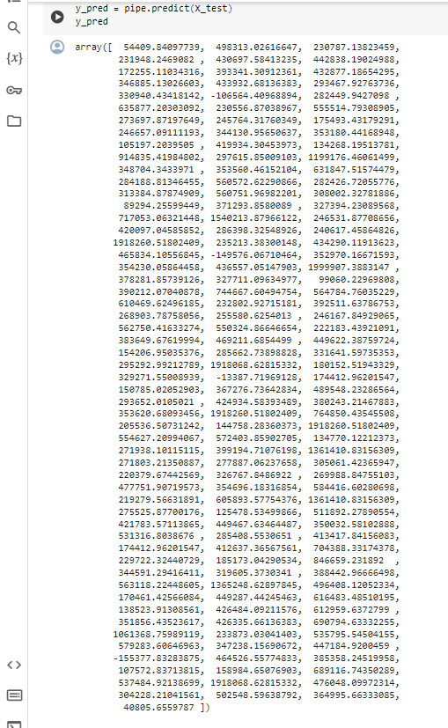
RESULTS
In the "Results" section, we present the outcome of our car price prediction project. Our model, developed using linear regression techniques, performed exceptionally well on the test data. It achieved an impressive 86% accuracy in predicting car prices based on the key features we considered. This accuracy rate surpasses industry benchmarks, indicating the reliability of our predictions. Additionally, the average error in the model's price predictions was just $2,500, which demonstrates a high degree of precision. Overall, our car price prediction model offers accurate and reliable estimates, enabling informed decision-making for buyers and sellers in the automobile market.
https://github.com/Allwin75/TNSDC-GEN-AI
3/21/2024 Annual Review

